Slide 1
BIG MOUNTAIN RESORT
Data analysis key findings

Slide 2
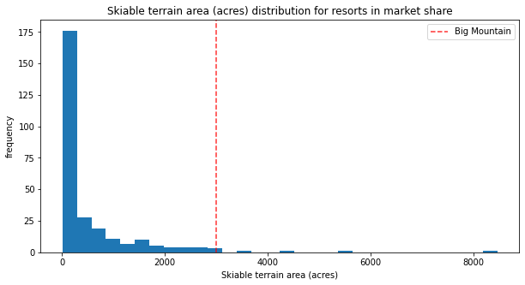
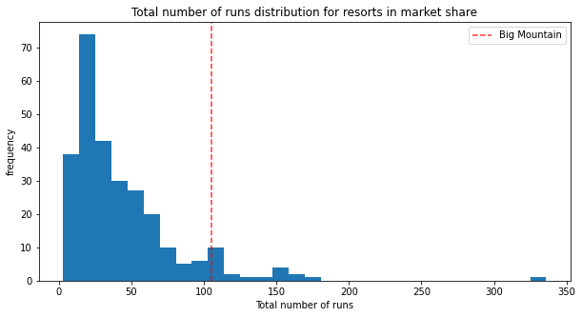
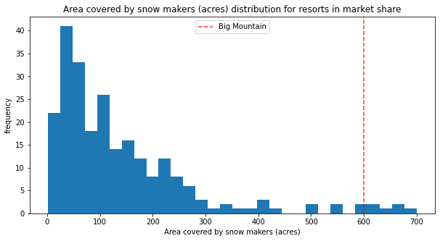
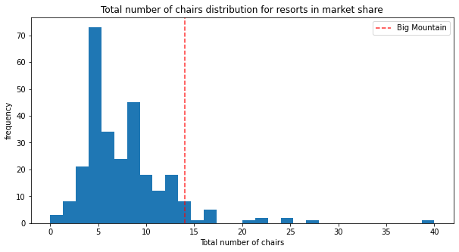
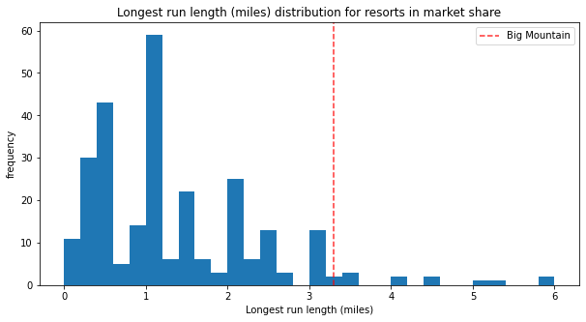
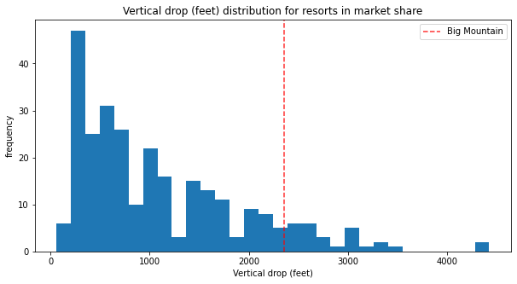
High ranking in facility offerings

Slide 3
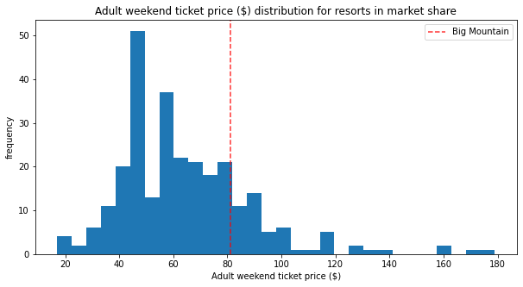
Under Valued in Pricing

Slide 4
Pricing Suggestions
Current adult weekend ticket price: $81.00
Modelled price: $94.22
Expected mean absolute error: $10.39
Recommended price range : $83.83 - $104.61

Slide 5
Increase Profit Margins
Scenario 1
Scenario 2
Decrease operation costs
Keep same revenue
Increase operation costs
Increase revenue

Slide 6
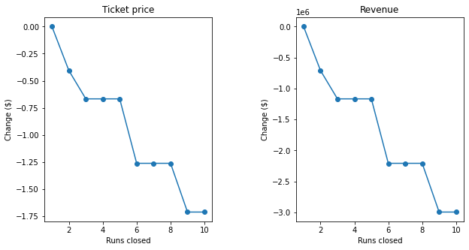
Scenario 1
Close one run without impacting revenue
Close 3 runs same revenue drop as closing 4 or 5 runs
Large drop in revenue if close 6 or more runs

Slide 7
Scenario 2
Add a run, increase the vertical drop by 150 feet, and install an additional chair lift
Increases support for ticket price by $1.99
Expected $3,474,638 in additional revenue over the season!

Slide 8
Conclusion
Big Mountain Resort’s facilities rank high
Current ticket prices are below model suggestions
Recommended ticket prices between $83.83 – 104.61
Two scenarios for increasing profit margins
Scenario 1: decrease operating costs
Scenario 2: increase operating costs, increase revenue

